Slide 1

Dynamic car racing

Slide 2
Submitted by: guide: dr.ashwin
Asif Ali Sherani 19MIM10104
Dhruv Arora 19MIM10014
Naman Arora 19MIM10057
Shrey Shrivastava 19MIM10056

Slide 3
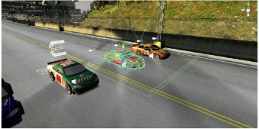
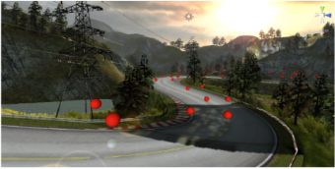
Introduction
Games have become an integral part of everyday life for many people. A traditional game often presents a situation where players engage in an artificial conflict, defined by rules and results in a quantifiable outcome.
The racing game is a contemporary video game, and its objective is to offer the player a challenging and enjoyable experience in a car race against a game-controlled car.

Slide 4
Existing work with limitations
Today there are numerous racing games that uses the technology of artificial intelligence in the racing bots in the game.
Traditionally, hard-coded methods such as state machines, rule bases systems, and scripting are used for AI in commercial games. The problem with these methods is that they are static, can be hard to expand, and time is needed to hand tune parameters.
All AI bots are all the same due to which the real time players gets bored playing the same game again and again. As such it seems that the bots are not interactive with the players.
Some of the racing games available nowadays are Need for speed(NFS), Forza horizon, real racing etc.

Slide 5
Novelty of the project
Usually the AI implementation in games is static i.e. the bot does not interact with player.
The implementation here is dynamic i.e. its difficulty level will change during the gameplay because of its interaction with the player.
Usually the game pre determines the difficulty level based on the input give by the player and it remains constant throughout the game until and unless changed explicitly by the user whereas here the difficulty of the game will be changing throughout the game by assessing the skills of the player during gameplay.

Slide 6
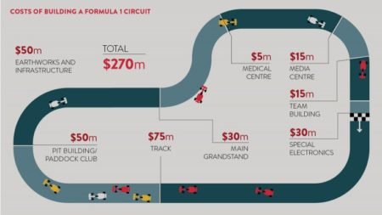
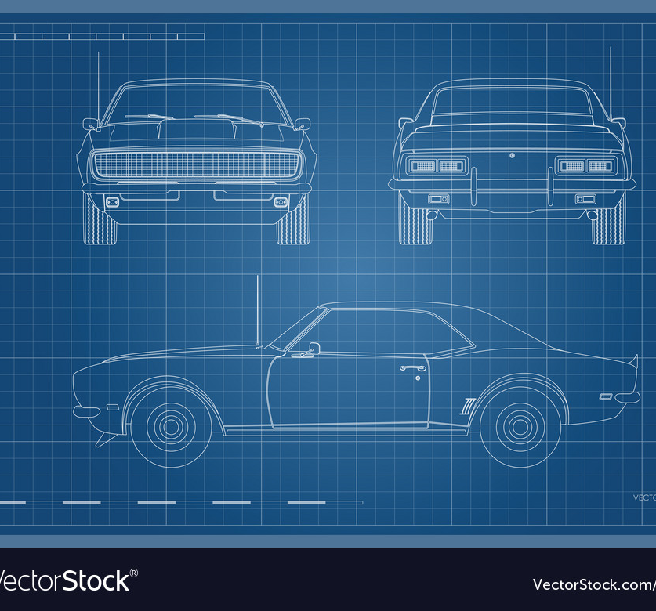
Proposed work
Using blender to create models of the assets required throughout the game I.e. cars, race tracks, roads etc.
Using unreal engine as the game engine which should also provide us with a physics and rendering engine.
Programming of game mechanics in C++ using Microsoft visual studio.
Using tensor flow python library for development of game AI.
Initial training of the game AI.

Slide 7
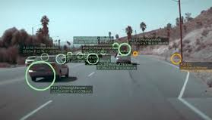
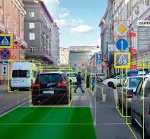
methodology
The enemy AI will keep track of the constant changing of race course and obstacles.
The enemy AI will change its course of action by analyzing the actions performed by human player
The enemy AI will interact with the environment and human player to give an immersive experience

Slide 8

Real-Time usage
Having intelligent bots as competition or help in a game allows players to experience multi-player gameplay without being online.
Game bots can help you boost retention and grow your Instant Games:
Game Bots can be a powerful retention and re-engagement mechanic when used effectively, but used poorly they can provide an annoying player experience and drive users away from your game. Bots tend to be more successful when considered as an integral part of the core engagement loop and a key component of the initial game design, as opposed to an ill-considered add-on at the end.
In fact, we've seen game developers increase their retention by over 25% by incorporating bots and optimizing the experience.

Slide 9
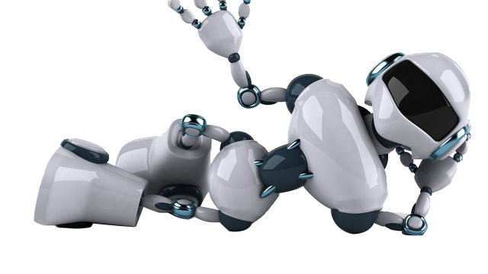
Use bots to re-engage players:
Bots can be a way to encourage players to engage with their friends, which tends to lead to higher retention on the platform.
We've also seen some really interesting use cases to provide a user with new information about the game to help re-engage; hints on a puzzle they were working on, daily game updates, or rewards for returning.

Slide 10
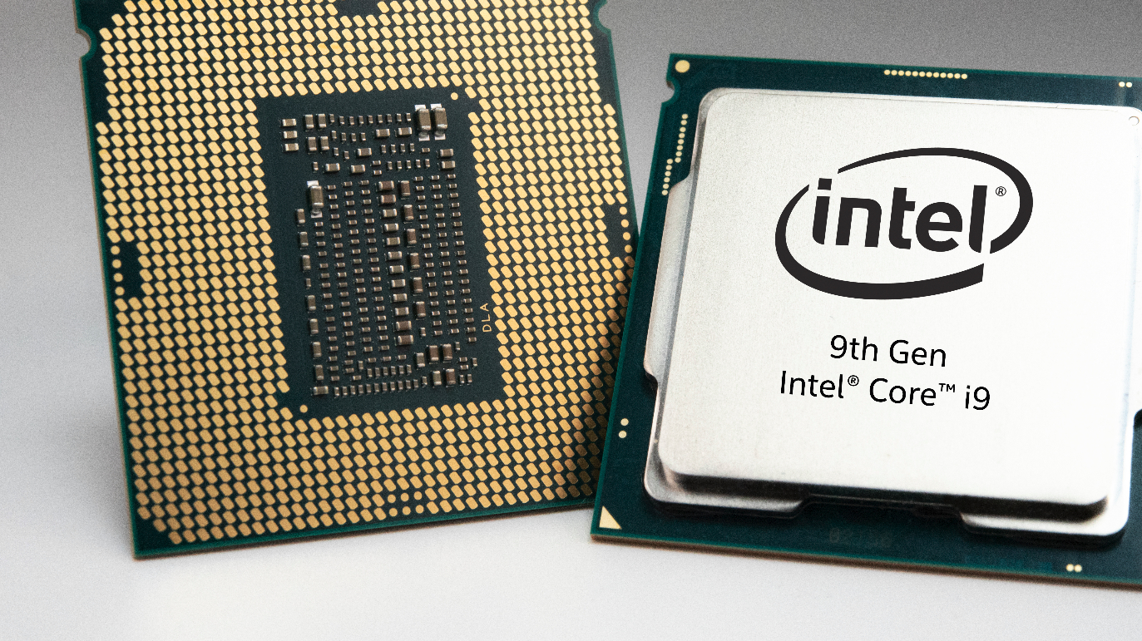
Hardware and software requirements
Hardware requirements:
Desktop PC or Notebook computer
For unreal engine:
Windows 7 sp1 or later / mac OS 10.9.2 or later.
Quad-core intel or AMD processor, 2.5 GHZ or faster.
8 GB RAM or more.
Nvidia GEFORCE GTX series or AMD Radeon series graphics card.
Software requirements:
Windows/ Mac OS or Linux.
Microsoft visual studio community edition.
Microsoft visual studio code.
Unreal engine 4.

Slide 11
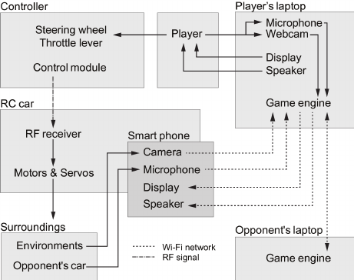
Overall system architecture diagram

Slide 12

Thank You

